Slide 1
GCP Machine Learning
AI build blocks: Sight, Language, Conversation and AutoML
AI Platform: Notebook, Training and Prediction
Q&A

Slide 2
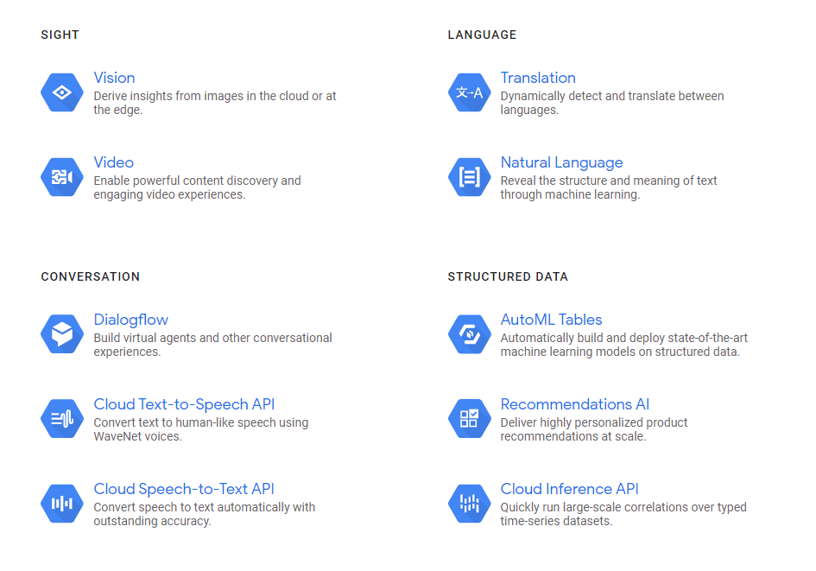
AI build blocks: Sight, Language, Conversation AutoML

Slide 3

VISION
Client library, RESTful API, RPC API
Classify images using pre-defined labels
Detect objects
Enable vision product search
Detect printed and handwritten text
Detect faces
Identify popular places and product logos
Assign general image attributes
Detect web entities and pages
Moderate content
Celebrity recognition

Slide 4
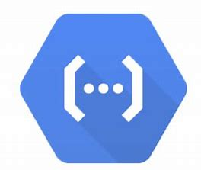
VIDEO
Client library, RESTful API, RPC API
Classify video using predefined labels
Detect shot changes
Detect and track objects
Detect and extract text
Moderate content
Analyze streaming and stored video
Automate video transcription for closed captioning and subtitles
Celebrity recognition

Slide 5
Supported format
The Video Intelligence API supports common video formats, including .MOV, .MPEG4, .MP4, .AVI, and the formats decodable by ffmpeg.

Slide 6
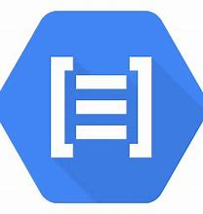
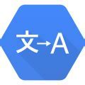
Translation
Natural language
Language Detection
Batch Translations
100+ Language Pairs
Syntax analysis
Entity analysis
Sentiment analysis
Content classification
Multi-language

Slide 7






Conversation
Structured data
Dialog flow
Text-to-Speech API
Speech-to-Text API
AutoML Tables(pre-release)
Recommendation AI(beta)
Cloud Inference API(alpha)

Slide 8
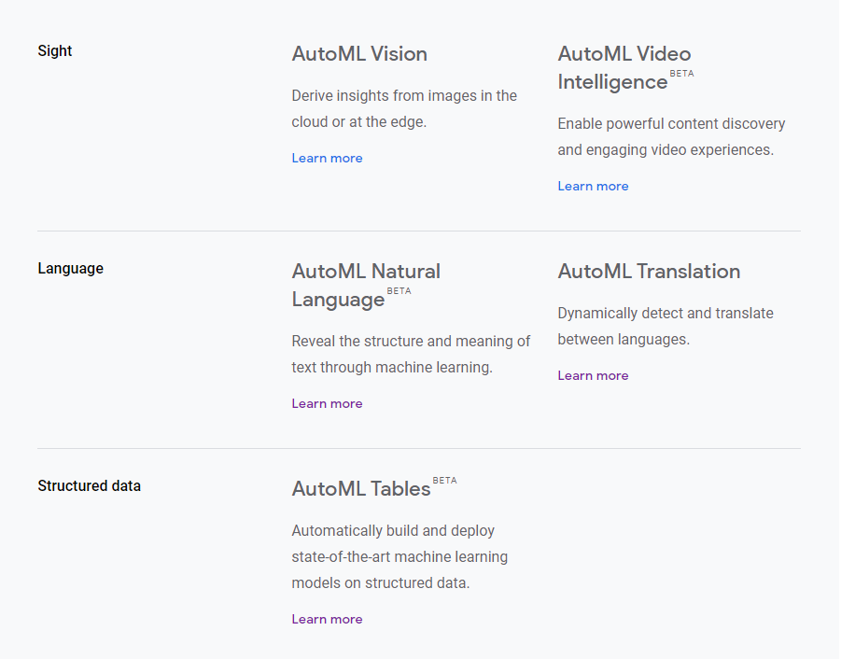
AutoML

Slide 9
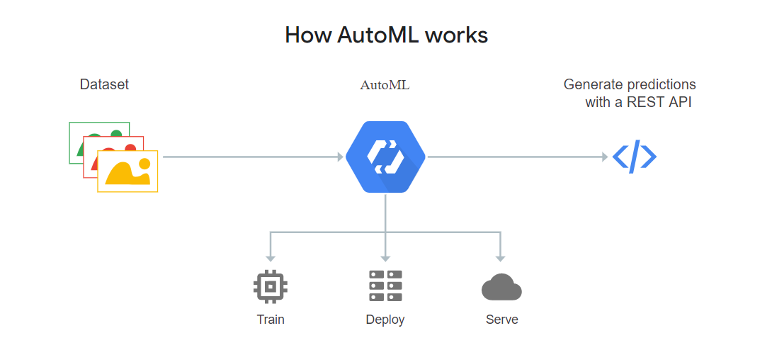
AutoML

Slide 10
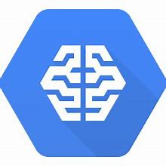
AI platform: Notebook
Training
Prediction

Slide 11
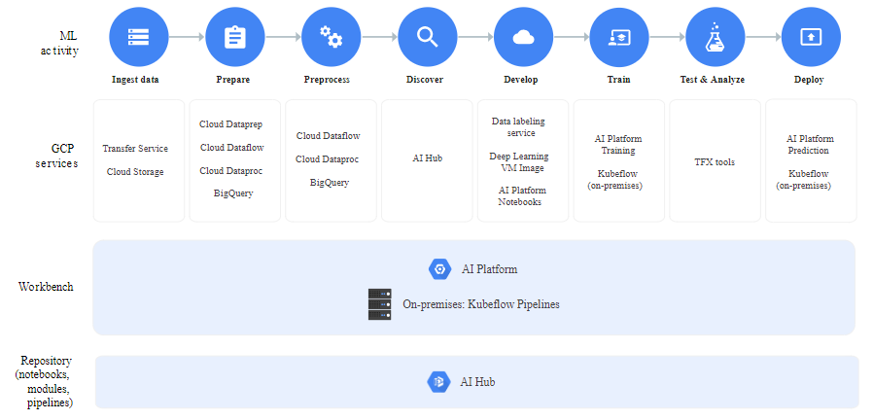
AI Platform
Machine learning development: the end-to-end cycle

Slide 12
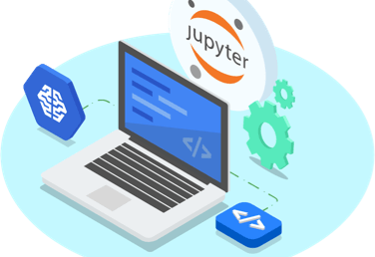
AI Platform Notebook
Managed JupyterLab notebook instances
Pre-configured Machine learning VM Image with open source frameworks and GCP support: scikit-learn, Tensorflow, PyTorch, R, BigQuery, Dataproc, Dataflow
Scale on demand: CPU/GPU/TPU, distributed service

Slide 13
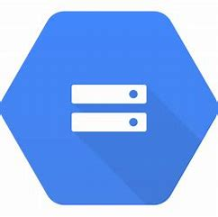
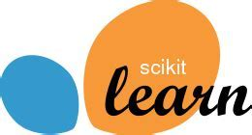
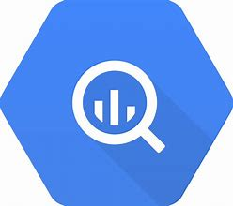

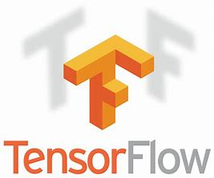
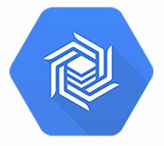
AI Platform Training
Preconfigured and customizable machine scale-tier
Preconfigured machine learning framework and GCP support: scikit-learn, XGBoost, Tensorflow, Cloud Storage, BigQuery
Custom container supported
Easily scalable, distributed training enabled for both Tensorflow and Custom container(e.g. MXNet, PyTorch)
Features

Slide 14


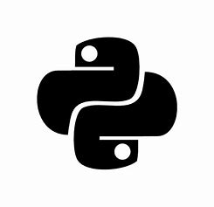



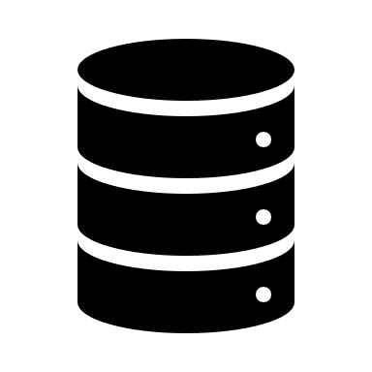
AI Platform Training
Download dataset from Cloud
Train model
Upload trained model to Cloud
Workflow in Python scripts
Get your data ready in Cloud Storage, Bigtable or other storage
Prepare you Python scripts
Pack your scripts
Run training command
Access trained model in Cloud
Workflow in Training Job
Workflow

Slide 15
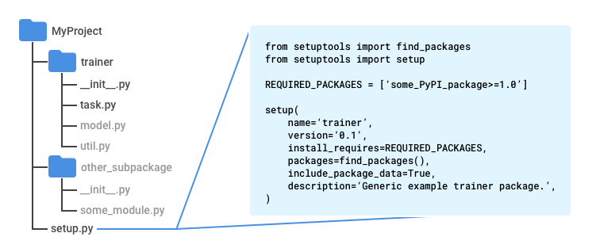
AI Platform Training
Package your Python scripts
trainer: package that contains your main scripts
task.py: your main module inside trainer
setup.py: specify any prerequisite of your model
config.yaml(optional): specify configuration of your training job
config.yaml: trainingInput:
scaleTier: BASIC_GPU
pythonVersion: '3.7’
runtimeVersion: '1.14'
Package your Python scripts

Slide 16
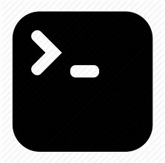
AI Platform Training
gcloud ai-platform jobs submit training $JOB_NAME \
--package-path $TRAINER_PACKAGE_PATH \
--module-name $MAIN_TRAINER_MODULE \
--job-dir $JOB_DIR \
--region $REGION \
--config config.yaml \
-- \
--user_first_arg=first_arg_value \
--user_second_arg=second_arg_value
Run training command

Slide 17
AI Platform Prediction
Online prediction/ Batch prediction
Preconfigured machine learning framework and GCP support: scikit-learn, XGBoost, Tensorflow, Cloud Storage, BigQuery
Custom container supported
Elastic prediction resources
Features

Slide 18

AI Platform Prediction
Analyze input query and make model prediction
Convert prediction to JSON serializable output and return
Read model file from Cloud
Workflow in Python Scripts
(Predictor class)
Pack your scripts and upload to Cloud Storage
Create model and version resource
Prepare you Python scripts for prediction
Get your model ready in Cloud Storage
Send request for prediction
Workflow in prediction job
Workflow

Slide 19

AI Platform Prediction
Package your Python scripts
predictor.py: module containing a Predictor class that implement predict method
setup.py: indicate scripts to pack
Run setup.py to pack your scripts as .tar.gz file
Upload to Cloud Storage
prediction_script.tar.gz
predictor.py
preprocessor.py(optional)
setup.py(optional)
Package your Python scripts

Slide 20
AI Platform Prediction
Create model resource
gcloud ai-platform models create $MODEL_NAME --regions $REGION
Create version resource
gcloud ai-platform versions create $VERSION_NAME \
--model $MODEL_NAME \
--runtime-version 1.15 \
--python-version 3.5 \
--origin $PATH_TO_MODEL \
--package-uris $PATH_TO_CODE \
--prediction-class predictor.MyPredictor
Create model and version resource

Slide 21
Resources
https://cloud.google.com/products/ai/
https://github.com/hhjjnn/GCP_template.git

